Slide 1
Global Office 365 Bootcamp – Sacramento
Eric Overfield
Microsoft Regional Director
Office Servers and Services MVP
President, PixelMill

Slide 2
Agenda
Time | Topic / Activity | Speaker
9 am | Introduction to SharePoint Framework | Eric Overfield
10:30 am | Break – 15 minutes
10:45 am | Deep dive into SharePoint Framework Webparts | Eric Overfield
12:15 pm | Lunch – 45 minutes
1 pm | Deeper dive into SharePoint Framework Webparts | Eric Overfield
2:30 pm | Break – 15 minutes
2:45 pm | SharePoint Framework Packaging and Deployment | Ryan Schouten
4:15 pm | Q&A and Wrap up – 15 minutes | Eric and Ryan

Slide 3
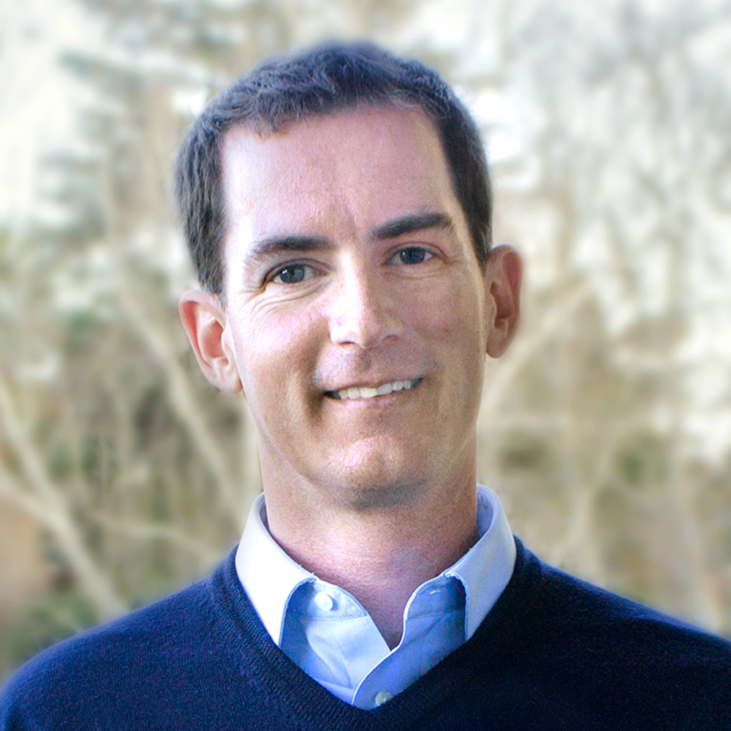





ERIC OVERFIELD
President & Co-Founder of PixelMill
Microsoft MVP, Office Servers & Services
Microsoft Regional Director
Published SharePoint Author
SharePoint Community Organizer & Contributor
ericoverfield.com
@ericoverfield
Notes:
Will make available via event site or can download now

Slide 4
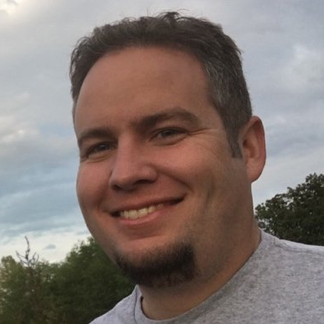



Ryan Schouten
Senior Architect at ZAACT
Microsoft MVP, Office Servers & Services
Microsoft Certified Trainer
ryanschouten.com
@shrpntknight
Notes:
Will make available via event site or can download now

Slide 5
Get Your Office 365 Developer Tenant (1 year usage, 25 users/tenant)
Utilize your free Office 365 Developer Tenant
Free for One Year
Includes 25 user licenses – E3
Comes pre-configured with demo users and content
Start with an incognito browser session
http://portal.office.com
Login using admin@DEV365x???.onmicrosoft.com
“meganb” account is also a global admin but with a profile

Slide 6
Get the source code
Download source code and slidedecks
http://github.com/eoverfield/Office-Dev-Bootcamp
Based on Office Development Master training source
https://github.com/OfficeDev/TrainingContent/tree/master/SharePoint/SharePointFramework

Slide 7

Call to action
(Recommendation to Bootcamp organizers and speakers: This slide can be used at the end of the Bootcamp to have attendees to fill online feedback form and recommendation for their ongoing learning and app development on Office 365 platform. Please keep the first three bullet points, you can update the last bullet point to be the user group or community that you are leading that you’d like attendees to join and learn more. Please keep the first feedback bullet point at the top and feel free to re-arrange the rest of bullet point orders. Thanks.
Share your feedback on Bootcamp at https://aka.ms/o365devbootcampfeedback
Join Office 365 developer program https://dev.office.com/devprogram to leverage all resources for Office 365 development learning
Build applications on Office 365 platform
Attend MVP led local community events to continue learning on Office 365 development

Slide 8

Enjoy the Bootcamp

